Slide 1
Why just kevin bacon?
Parth Vadera

Slide 2
Kevin bacon game
Most of us have heard about the Kevin Bacon game
The game requires a group of players to try to connect any Hollywood actor to Kevin Bacon as quickly as possible and in as few links as possible
But why Kevin Bacon!?
No doubt he is a prolific and versatile actor but are there others like him or maybe more connected and influential than him
Let’s hunt for a better substitute actor who is relatively young, prolific, deeply entangled in the network

Slide 3
Actors of interest
Kevin Bacon
Nicolas Cage
George Clooney
Tom Cruise
James Franco
Tom Hanks
Samuel L. Jackson
Ben Affleck
Brad Pitt
Keanu Reeves

Slide 4

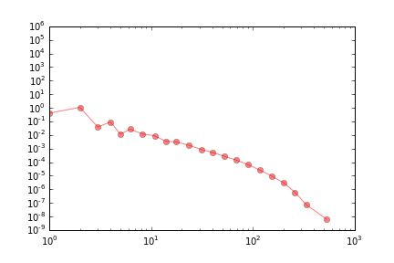
Network:
Filter: Made after 1960
Number of Nodes: ~1.2 Million
Number of Edges: ~2.8 Million
Degree Distribution
Data courtesy: Nicola Perra

Slide 5
Sampling
Three types of sampling methods considered.
DFS – It samples an unvisited neighbor of the most recent visited vertex without backtracing
BFS - It samples an unvisited neighbor of the earliest visited vertex and each node is visited at most once.
Random Walk – Random Walkers sample the network through diffusion

Slide 6
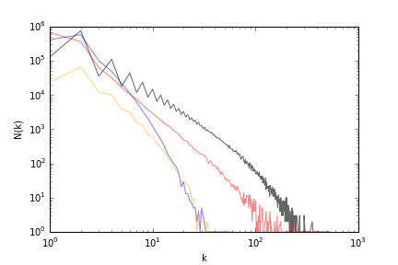
- Black is the original network
- Red is BFS which is biased towards node with high degree as expected
- Blue is DFS, biased like BFS
-Orange is random walk
- BFS does a better job of approximating the network ( ~1.1 million edges)

Slide 7
Degree
Entire Dataset
Sampled Dataset

Slide 8
Page Rank
Entire Dataset
Sampled Dataset

Slide 9
Eigen Value centrality
Entire Dataset
?
Eigen Value Centrality for sampled
dataset did not converge

Slide 10
K-core Decomposition
A k-degenerate graph is an undirected graph in which every subgraph has a vertex of degree at most k: that is, some vertex in the subgraph touches k or fewer of the subgraph's edges.
All actors except Ben Affleck lie in the 11th core for entire dataset. Ben sits in the 9th one.
But for the sampled dataset k-core for all the actors is 1

Slide 11
The verdict
Real | Rank | Sample
Samuel Jackson | 1 | Samuel Jackson
Brad Pitt | 2 | Brad Pitt
Kevin Bacon | 3 | James Franco
Keanu Reeves | 4 | Keanu Reeves
Tom Hanks | 5 | Nicolas Cage
James Franco | 6 | George Clooney
George Clooney | 7 | Tom Cruise
Tom Cruise | 8 | Ben Affleck
Ben Affleck | 9 | Tom Hanks

Slide 12
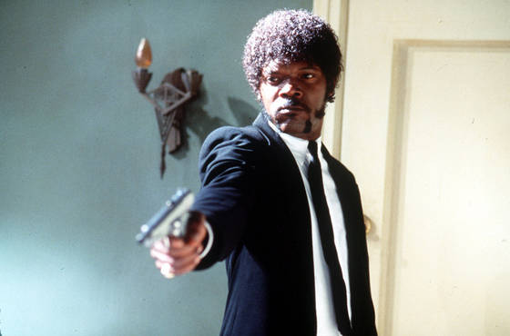
Jackson is the new bacon

Slide 13
Community detection
Tried using community_fastgreedy from the package igraph, with 5 desired clusters as input to seprate Hollywood from other movie industries.
Clusters from this output wasn’t able to segregate Hollywood. (Maybe because the algorithm is greedy)
Computed the partition of the graph nodes which maximizes modularity i.e. the highest partition of the dendogram
Generated by the Louvain algorithm
21874 communities detected with modularity 0.8345

Slide 14
Community of actors of interest
Ben Affleck
Tom Cruise
Kevin Bacon
Nicholas Cage
George Clooney
Brad Pitt
Tom Hanks
Keanu Reeves
Samuel L. Jackson
James Franco

